Slide 1
RENTIT
Presented By:
1.Miss SETTI YAMINI(S170746)
2. Miss KOTA SUCHARITHA(S171171)
3.Miss PANCHIREDDY PURNA(S170478)
4.Miss MEDABOINA SIVA DURGA(S170818)
Guided By:Mrs UMA MAHESWARI

Slide 2
OUTLINE
Abstract
Problem Statement
Aims , Objective & Proposed System/Solution
System Design
System Development Approach(Technology Used)
Conclusion
Future Scope

Slide 3
Abstract
As a student we need some things like casio, drafters for a small amount of time, We don't want to buy those things because we don’t use that particular item once our requirement is fulfilled. It will remain useless so we feel like it is a waste of money, instead of buying it we go for a rent through this website where students can get their needy things for rent at suitable prices.
Here we are planning to design a website to make renting things easy in a secure and simple manner. Our website acts as an intermediate between customer and client to rent things.

Slide 4
Problem Statement
Sometimes it is necessary to buy a thing which has less use but has high cost ,we will get into a dilemma whether we have to buy or not .There is a solution instead of buying it, that is to take rent for a particular span of time and after our use, we can return it. So there is no point in buying it anymore.

Slide 5
Proposed Solution
Here we are planning to design a website to make renting things easy in a secure and simple manner. Our website acts as an intermediate between customer and client to rent things. We are going to use HTML, CSS and JAVASCRIPT,EJS for frontend, NODE JS for backend and MONGODB for database.

Slide 6
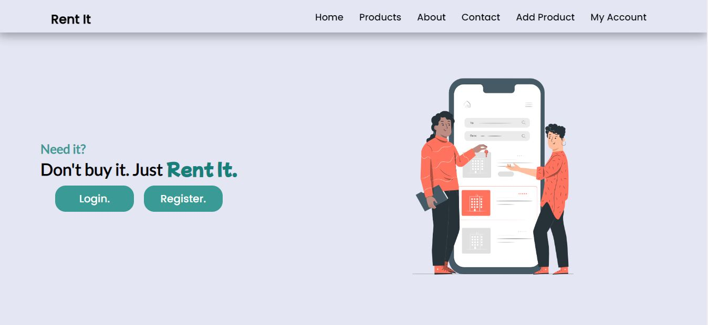
System Architecture

Slide 7
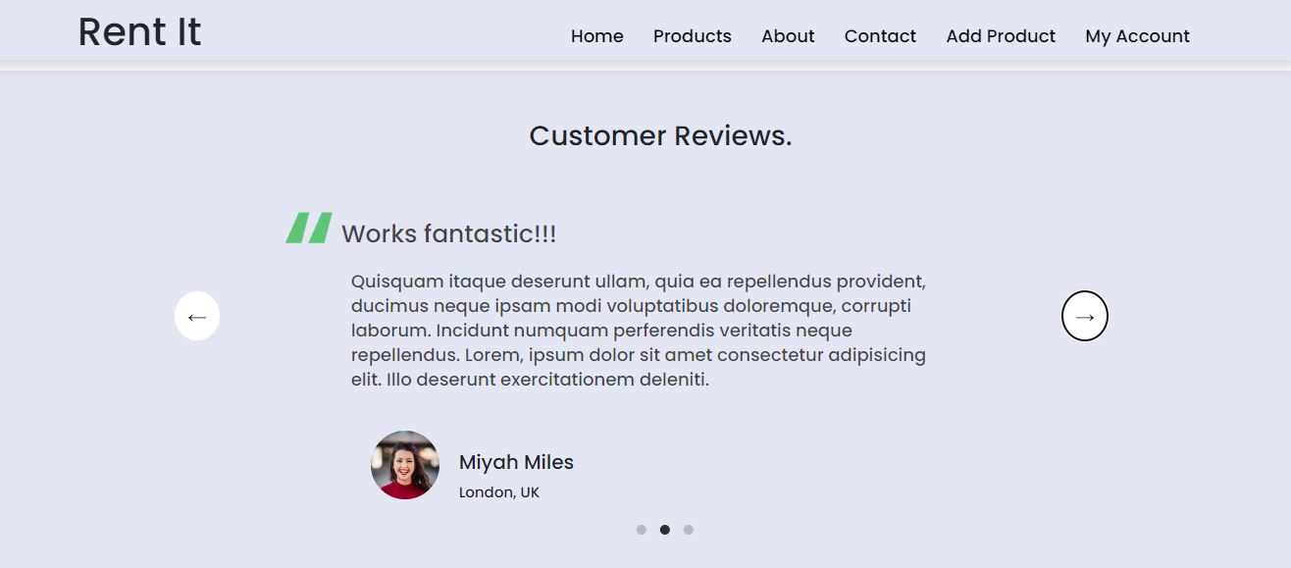
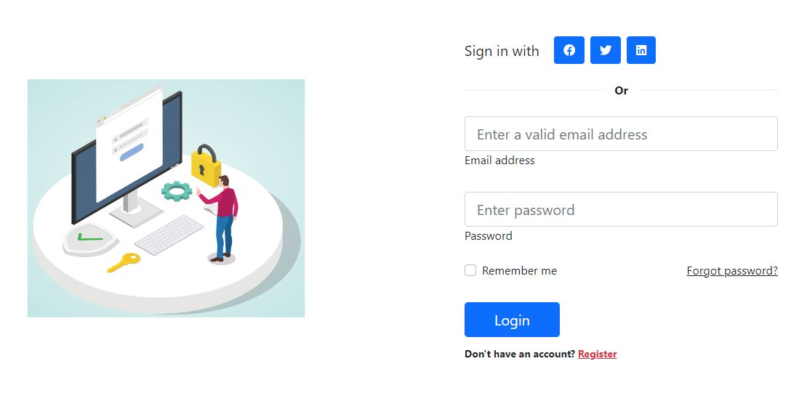

Slide 8
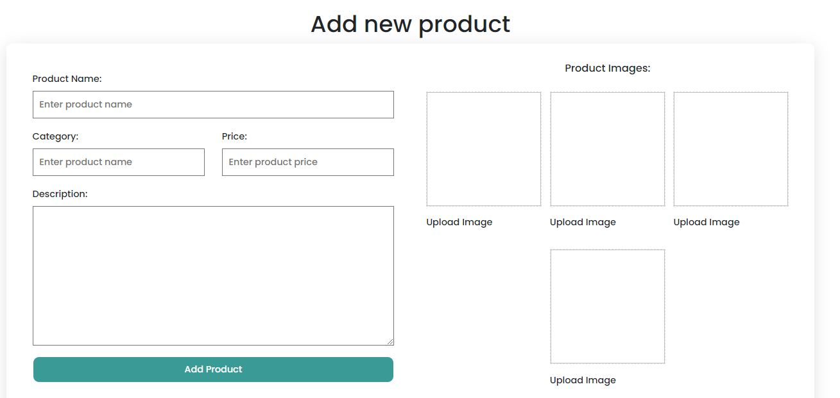
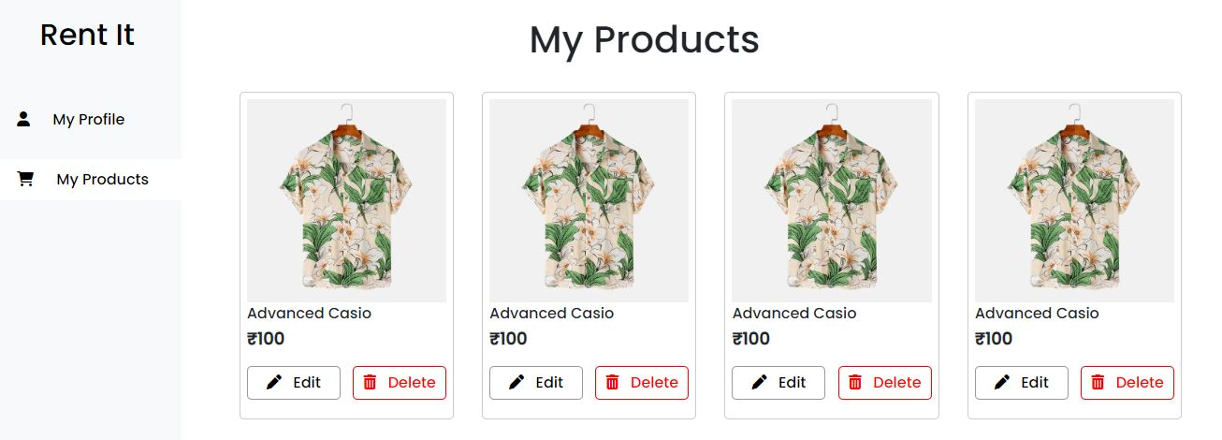

Slide 9
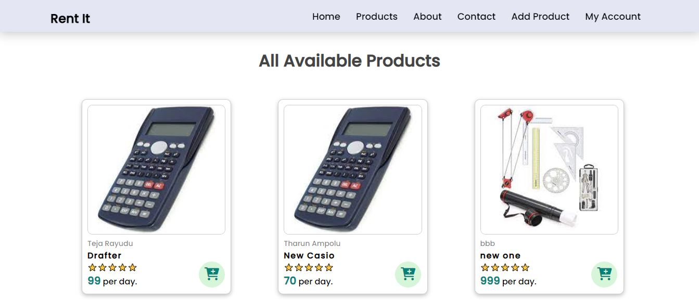
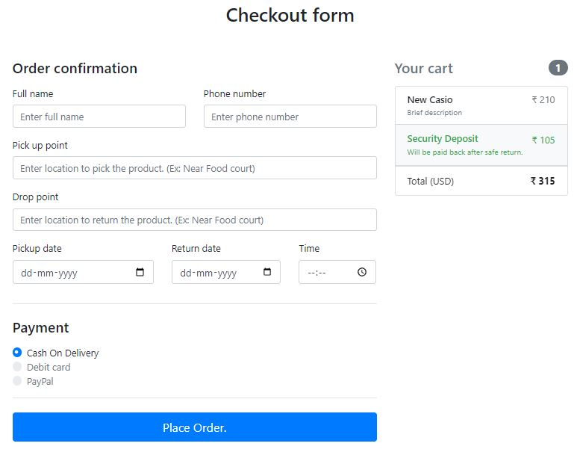

Slide 10
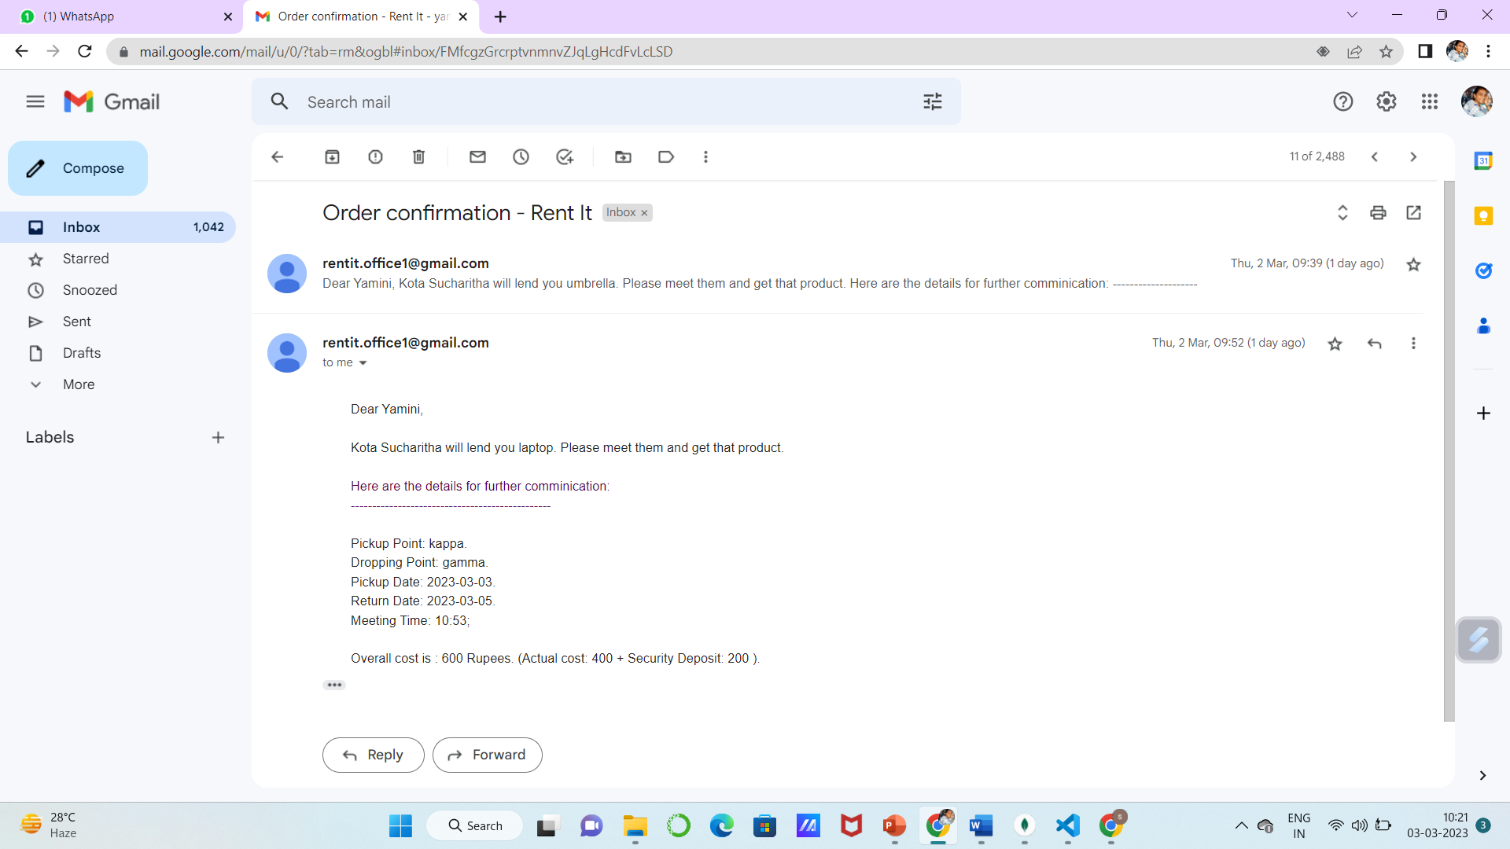
System Deployment Approach
Mail send to owner

Slide 11
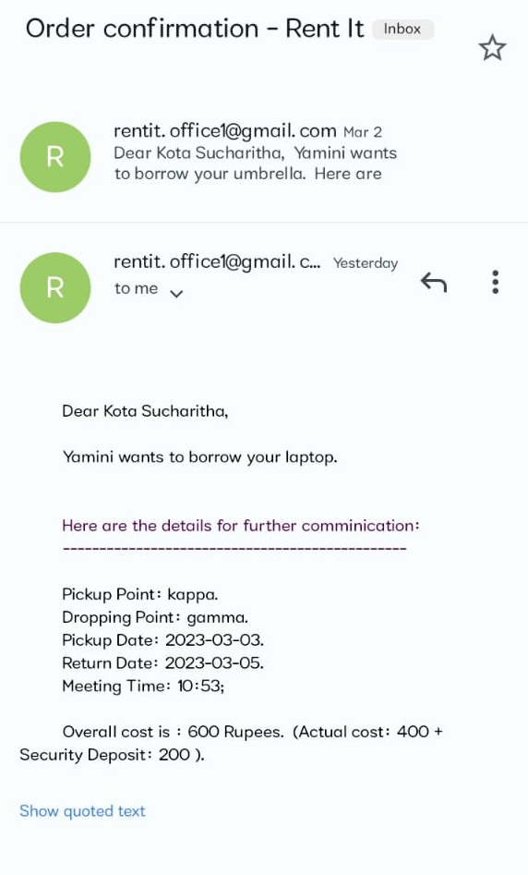
Mail send to borrower

Slide 12
FUTURE SCOPE
We are mainly focusing on building this project for RGUKT students. As we are not allowed to go outside of our campus to exchange things with people who are outside of this campus. So this project is being developed solely for RGUKT students.
Initially we are planning to implement major features like lending and borrowing, user profiles creation, uploading proofs while exchanging those products, etc.
There is a lot of scope for this project like implementing payment options, ratings for users and products so that whenever someone makes a request for a particular product then the owner can check the customer’s profile whether he/she is returning products on time or not. This works the same for products also, so that users can see reviews of those products from previous customers whether that particular product is working properly or not.

Slide 13
CONCLUSION
As a student we need some things like casio, drafters for a small amount of time, We don't want to buy those things because we don’t use that particular item once our requirement is fulfilled. It will remain useless so we feel like it is a waste of money, instead of buying it we go for a rent through this website, where students can get their needy things for rent at suitable prices.

Slide 14
Github link:
https://github.com/yaminiRgukt/RentIt

Slide 15
THANK YOU

